Slide 1
CS50W – Project1
Grace´s Virtual Library

Slide 2
Registration
Users should be able to register for your website, providing (at minimum) a username and password.

Slide 3
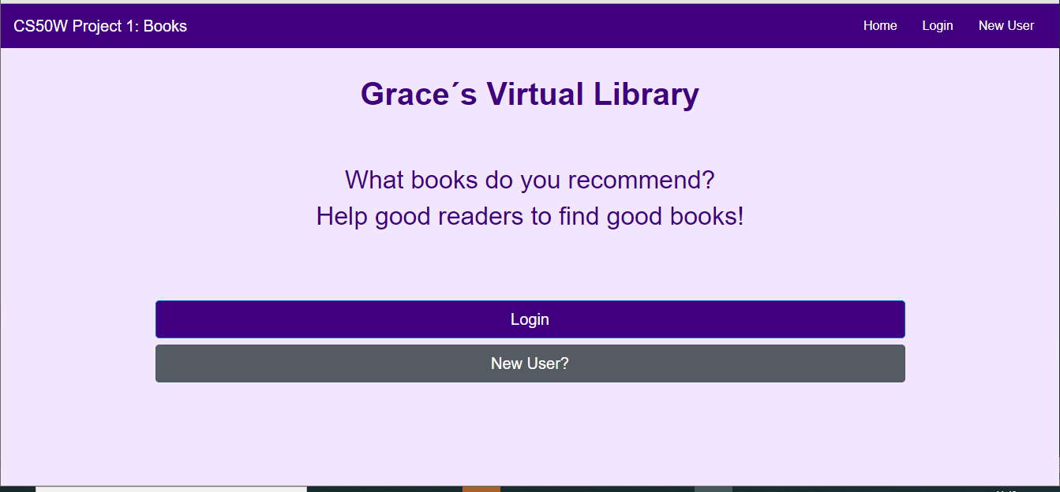

Slide 4
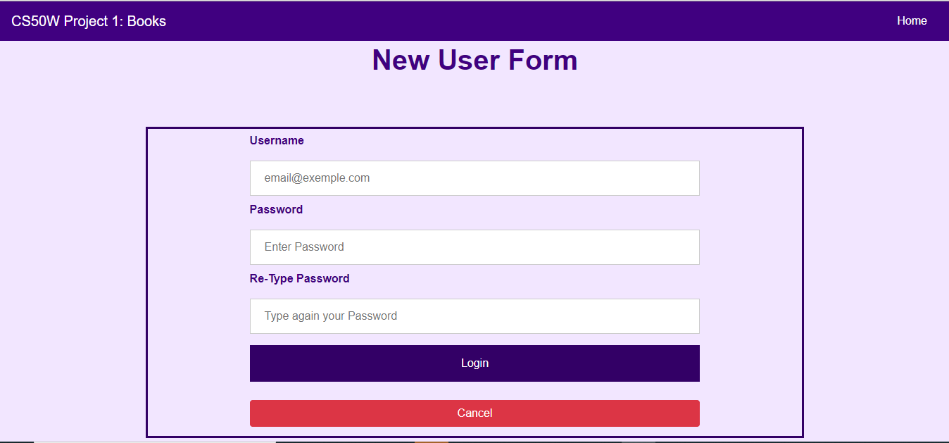

Slide 5
Login
Users, once registered, should be able to log in to your website with their username and password.

Slide 6
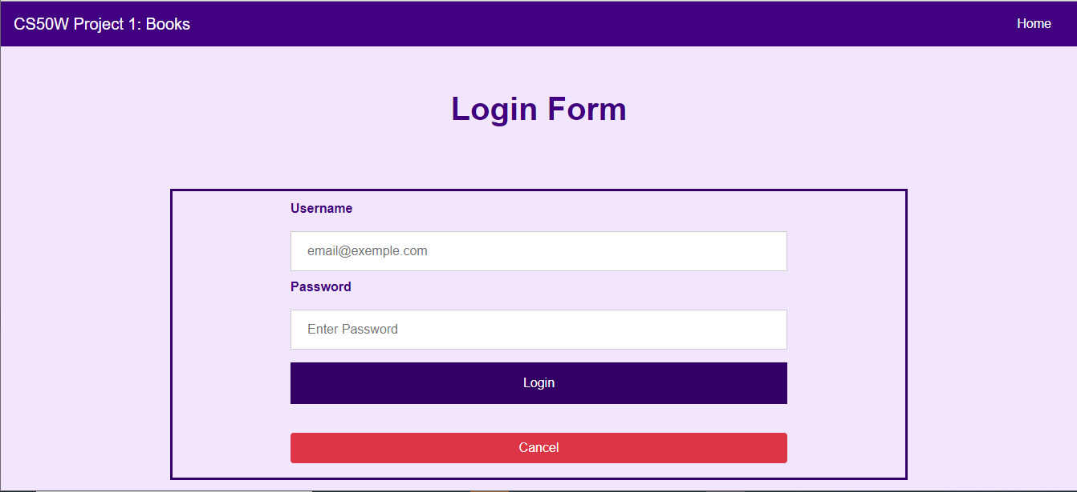

Slide 7
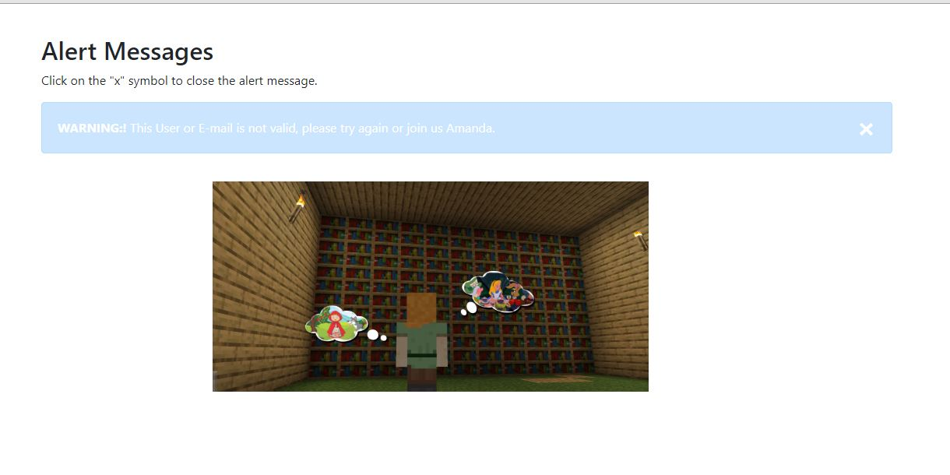
Wrong user or password message

Slide 8
logout
Logged in users should be able to log out of the site.

Slide 9


#Logout: Logged in users should be able to log out of the site.
@app.route('/logout')
def logout():
if 'user' in session:
del session['user']
return render_template("index.html", login="T" , logout="F" , register="T")

Slide 10
Import
Provided for you in this project is a file called books.csv, which is a spreadsheet in CSV format of 5000 different books. Each one has an ISBN number, a title, an author, and a publication year. In a Python file called import.py separate from your web application, write a program that will take the books and import them into your PostgreSQL database. You will first need to decide what table(s) to create, what columns those tables should have, and how they should relate to one another. Run this program by running python3 import.py to import the books into your database, and submit this program with the rest of your project code.

Slide 11
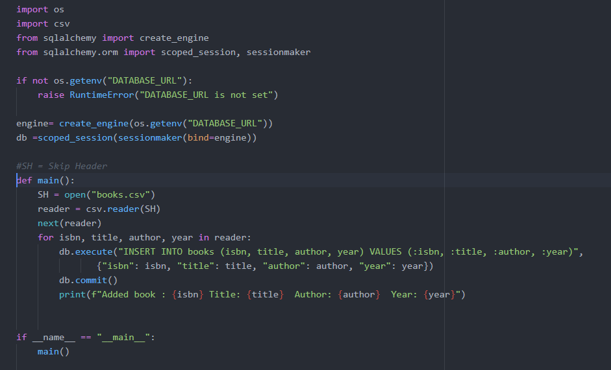

Slide 12
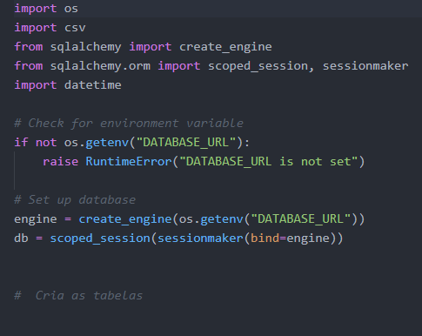
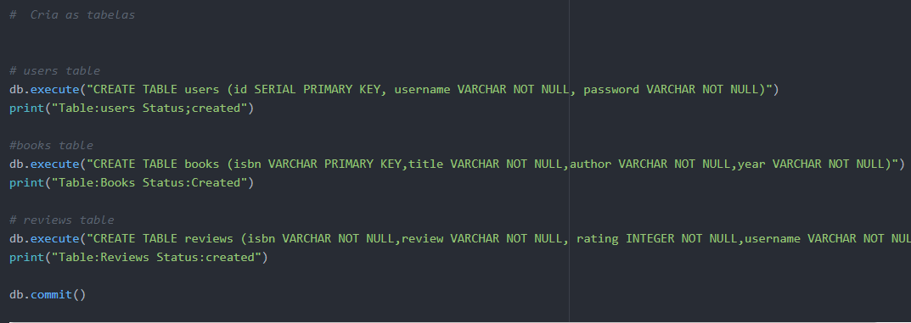
Create Tables

Slide 13
Search
Once a user has logged in, they should be taken to a page where they can search for a book. Users should be able to type in the ISBN number of a book, the title of a book, or the author of a book. After performing the search, your website should display a list of possible matching results, or some sort of message if there were no matches. If the user typed in only part of a title, ISBN, or author name, your search page should find matches for those as well!

Slide 14
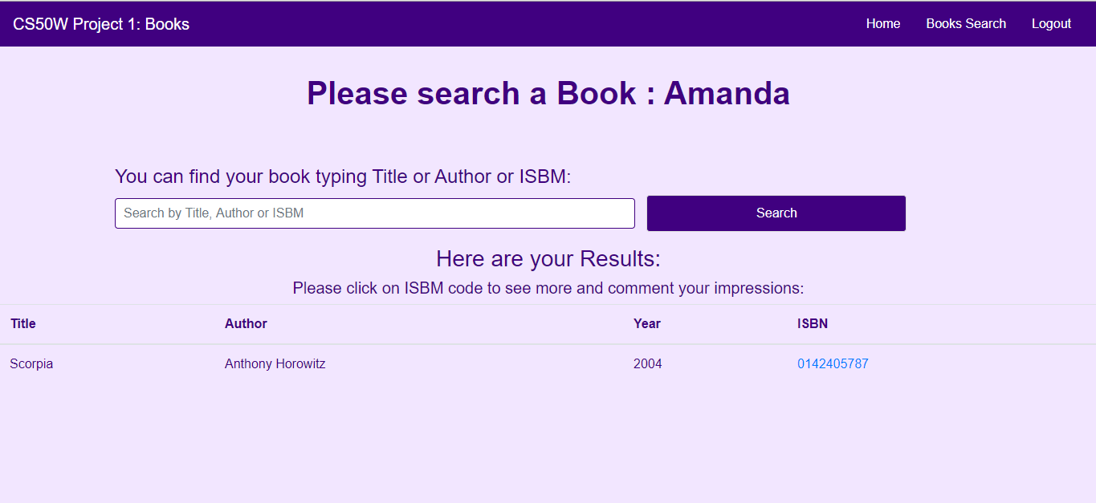

Slide 15
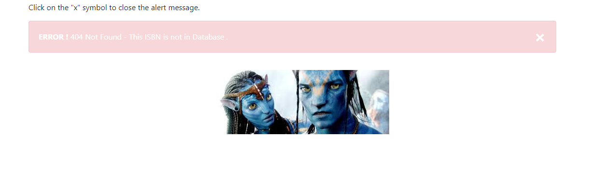
If the requested ISBN number isn’t in your database, your website should return a 404 error.

Slide 16
Book Page
When users click on a book from the results of the search page, they should be taken to a book page, with details about the book: its title, author, publication year, ISBN number, and any reviews that users have left for the book on your website.

Slide 17
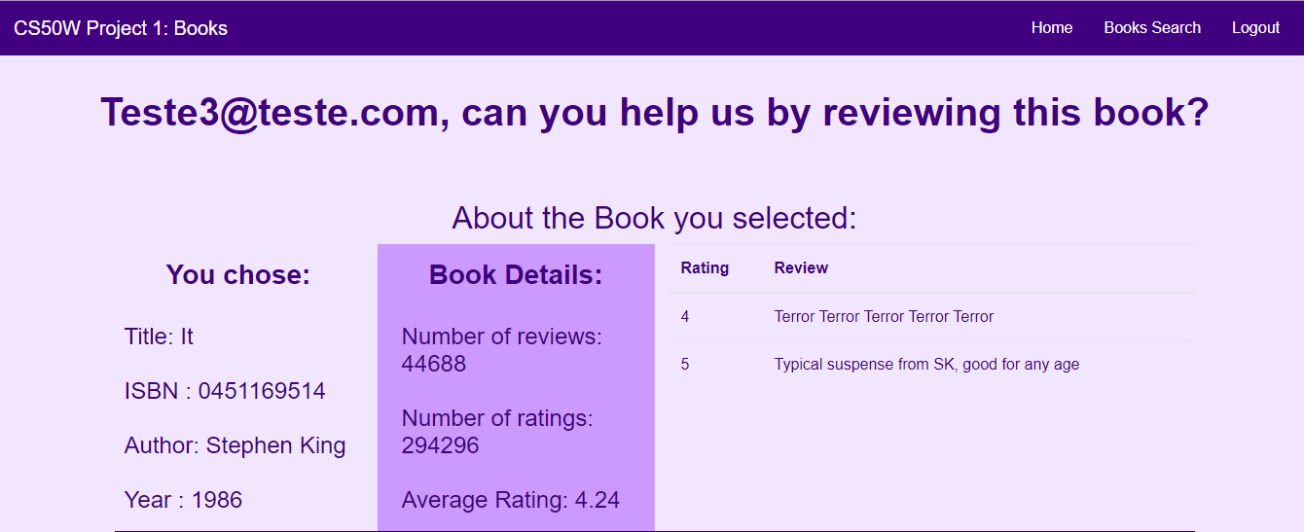

Slide 18
Review Submission
On the book page, users should be able to submit a review: consisting of a rating on a scale of 1 to 5, as well as a text component to the review where the user can write their opinion about a book. Users should not be able to submit multiple reviews for the same book.

Slide 19
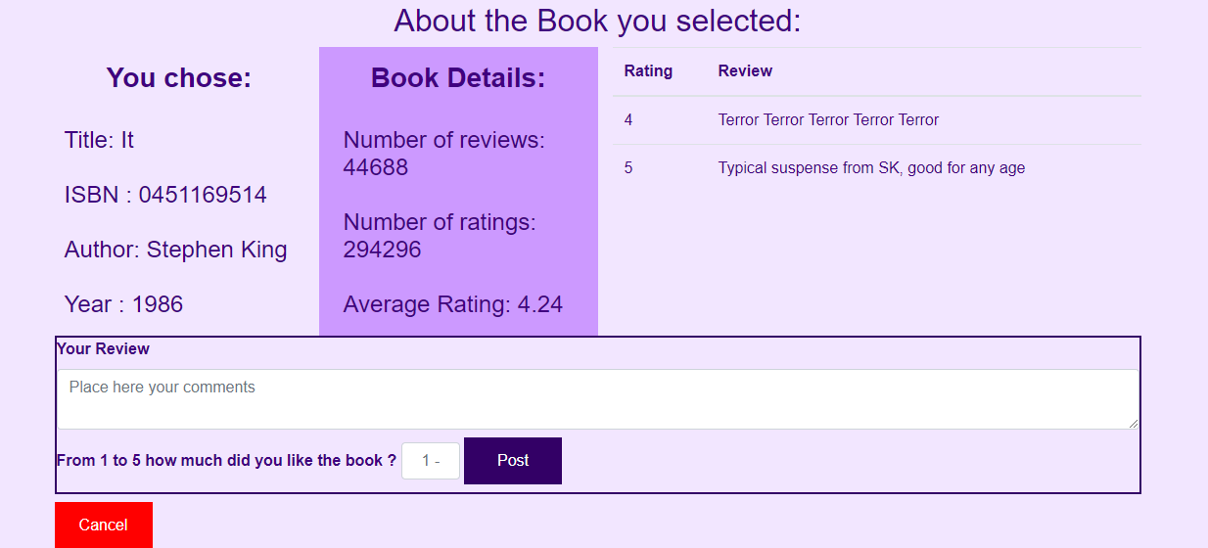

Slide 20
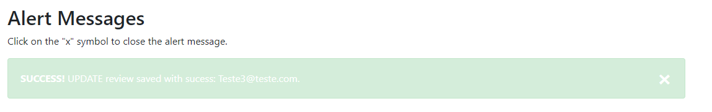
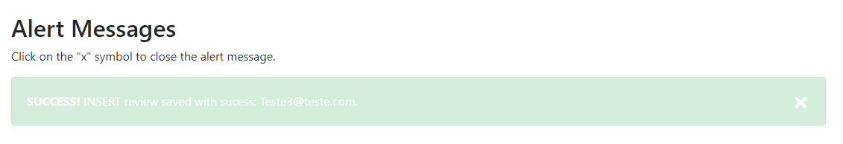

Slide 21
Goodreads Review Data /API Access
On your book page, you should also display (if available) the average rating and number of ratings the work has received from Goodreads.
If users make a GET request to your website’s /api/<isbn> route, where <isbn> is an ISBN number, your website should return a JSON response containing the book’s title, author, publication date, ISBN number, review count, and average score. The resulting JSON should follow the format:

Slide 22
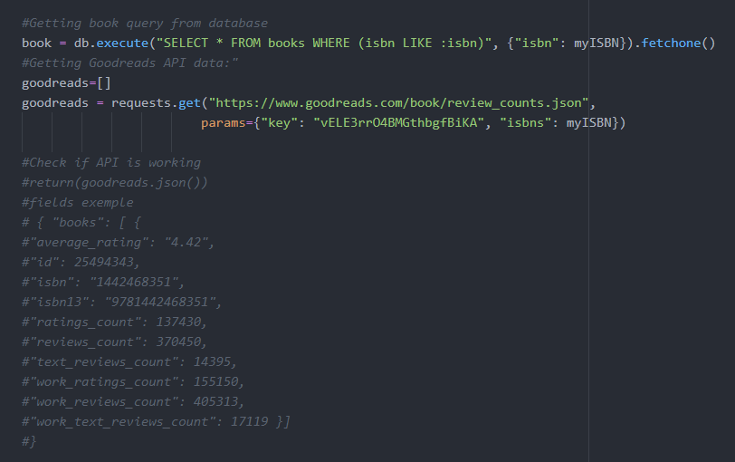
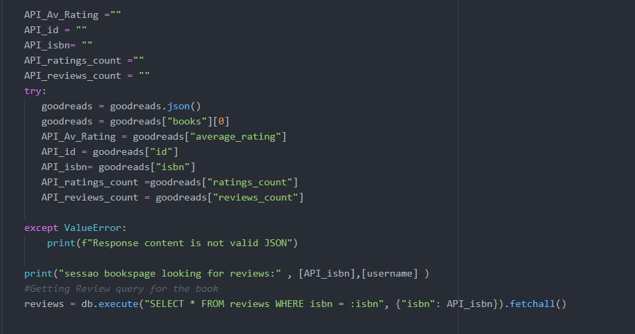
Good Reads API use

